Slide 1
1

Slide 2
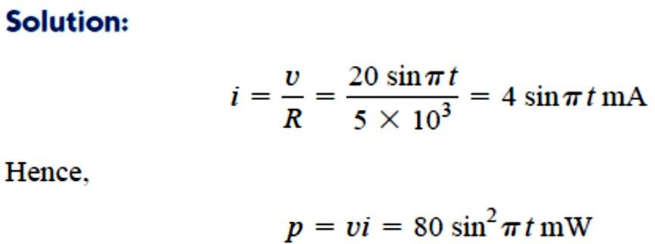
2
Basic Laws
2-6 Ohm’s Law
Ohm’s law states that the voltage v across a resistor is directly
proportional to the current i flowing through the resistor.
𝒗 𝜶 𝒊
⇒ 𝒗 = 𝒊𝑹
We may deduce from Eq. that
𝑣
𝑖
𝑅 =
Example 1/ A voltage source of 𝟐𝟎 𝒔𝒊𝒏 𝝅𝒕 V is connected across a
𝟓 𝑲Ω resistor. Find the current through the resistor and the power dissipated.
H.W. / A resistor absorbs an instantaneous power of 𝟐𝟎𝒄𝒐𝒔^{𝟐}𝒕 𝒎𝑾
when connected to a voltage source 𝒗 = 𝟏𝟎 𝒄𝒐𝒔 𝒕 𝑽. Find i and R.
Answer 𝟐 𝒄𝒐𝒔 𝒕 𝒎𝑨 , 𝟓𝑲Ω
A useful quantity in circuit analysis is the reciprocal of resistance R, known as conductance and denoted by G:
𝟏 𝒊
𝑮 = _{𝑹} = _{𝒗} (𝒊)
Conductance is the ability of an element to conduct electric current; it
is measured in mhos (O ) or siemens (S).

Slide 3
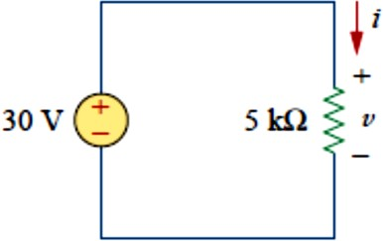
3
The same resistance can be expressed in ohms or siemens. For example, 10 Ω is the same as 0.1 S. From Eq. (i), we may write
𝒊 = 𝑮𝒗
The power dissipated by a resistor can be expressed in terms of R.
_{𝒗}𝟐
𝑹
𝒑 = 𝒗𝒊 = 𝒊^{𝟐}𝑹 =
The power dissipated by a resistor may also be expressed in terms of G as
_{𝒊}𝟐
𝑮
𝒑 = 𝒗𝒊 = 𝒗^{𝟐}𝑮 =
Example 2
In the circuit shown in Fig. 1, calculate the current i, the conductance G, and the power p.
Fig. 1

Slide 4
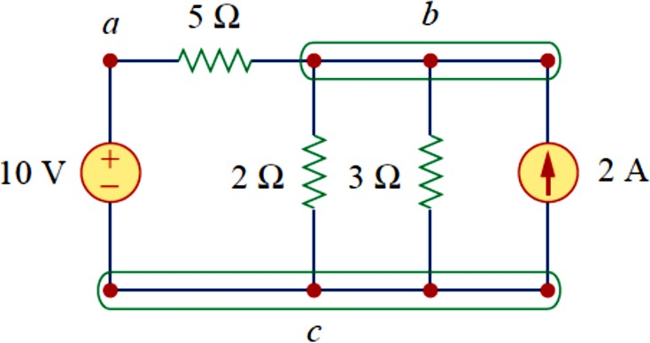
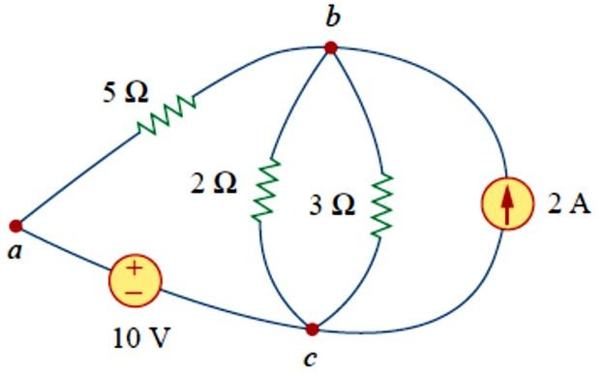
4
2-7 Nodes, Branches, and Loops
A branch represents a single element such as a voltage source or a
resistor.
In other words, a branch represents any two-terminal element. The circuit in Fig. 2 has five branches, namely, the 10-V voltage source, the 2-A current source, and the three resistors.
Fig 2
A node is the point of connection between two or more branches.
We demonstrate that the circuit in Fig. 3 has only three nodes by redrawing the circuit in Fig. 3.
Fig. 3. The three-node circuit of Fig. 2.1 is redrawn.
A loop is any closed path in a circuit.

Slide 5
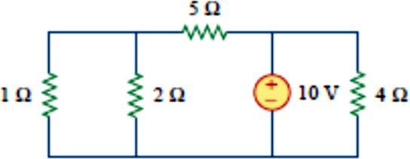
5
A loop is a closed path formed by starting at a node, passing through a set of nodes, and returning to the starting node without passing through any node more than once.
A network with b branches, n nodes, and l independent loops will satisfy the fundamental theorem of network topology:
𝑏 = 𝑙 + 𝑛 − 1
Example 3
How many branches and node does the circuit in Fig. 4 have?
Fig. 4
2-8 Kirchhoff’s Laws
Ohm’s law by itself is not sufficient to analyze circuits. However, when it is coupled with Kirchhoff’s two laws, we have a sufficient, powerful set
of tools for analyzing a large variety of electric circuits. Kirchhoff’s laws were first introduced in 1847 by the German physicist Gustav Robert
Kirchhoff (1824–1887). These laws are formally known as Kirchhoff’s current law (KCL) and Kirchhoff’s voltage law (KVL).
Kirchhoff’s current law (KCL) states that the algebraic sum of currents
entering a node (or a closed boundary) is zero.
Mathematically, KCL implies that
𝑁
∑ 𝑖_{𝑛} = 0
𝑛=1
( 1)
Where N is the number of branches connected to the node and 𝑖_{𝑛} is the
nth current entering (or leaving) the node. By this law, currents entering a

Slide 6
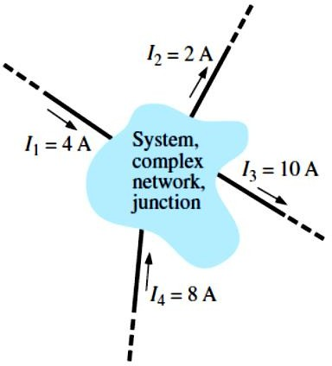
6
node may be regarded as positive, while currents leaving the node may be taken as negative or vice versa.
In Fig. 5, for example, the shaded area can enclose an entire system or a
complex network, or it can simply provide a connection point (junction) for the displayed currents. In each case, the current entering must equal that leaving, as required by above Eq.
Fig. 5 Introducing Kirchhoff ’s current law.
∑ 𝐼_{𝑖} = ∑ 𝐼_{𝑜}
𝐼₁ + 𝐼₄ = 𝐼₂ + 𝐼₃
4 𝐴 + 8 𝐴 = 2 𝐴 + 10 𝐴
12 𝐴 = 12 𝐴

Slide 7
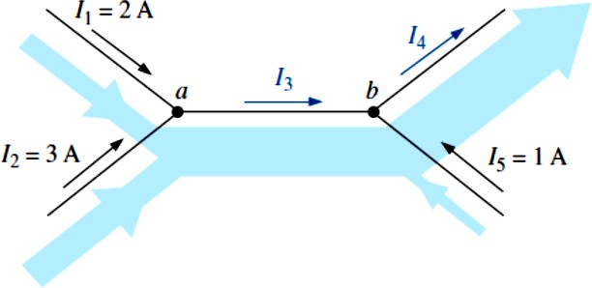
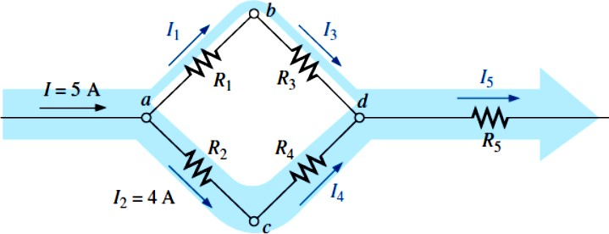
7
The sum of the currents entering a node is equal to the sum of the
currents leaving the node.
Example 4/ Determine currents I₃ and I₄ in Fig. 6 using Kirchhoff’s current law.
Fig. 6 Two-node configuration for Example.
Example 5- Determine currents I₁, I₃, I₄, and I₅ for the network in Fig. 7.
Fig. 7 Four-node configuration for Example

Slide 8
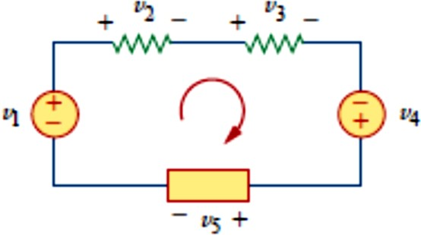
8
Kirchhoff’s voltage law (KVL) states that the algebraic sum of all
voltages around a closed path (or loop) is zero.
Expressed mathematically, KVL states that
𝑀
∑ 𝑣_{𝑚} = 0
𝑚=1
( 2)
Where M is the number of voltages in the loop (or the number of branches in the loop) and V_{m} is the mth voltage.
To illustrate KVL, consider the circuit in Fig. 8. The sign on each voltage is the polarity of the terminal encountered first as we travel around the
loop. We can start with any branch and go around the loop either clockwise or counterclockwise. Suppose we start with the voltage source and go clockwise around the loop as shown; then voltages would be
−𝑣₁, +𝑣₂, +𝑣₃, −𝑣₄ and +𝑣₅ in that order.
Fig. 8
For example, as we reach branch 3, the positive terminal is met first; hence, we have, +𝑣₃. For branch 4, we reach the negative terminal first; hence, −𝑣₄ Thus, KVL yields
−𝑣₁ + 𝑣₂ + 𝑣₃ − 𝑣₄ + 𝑣₅ = 0
Rearranging terms gives
𝑣₂ + 𝑣₃ + 𝑣₅ = 𝑣₁ + 𝑣₄

Slide 9
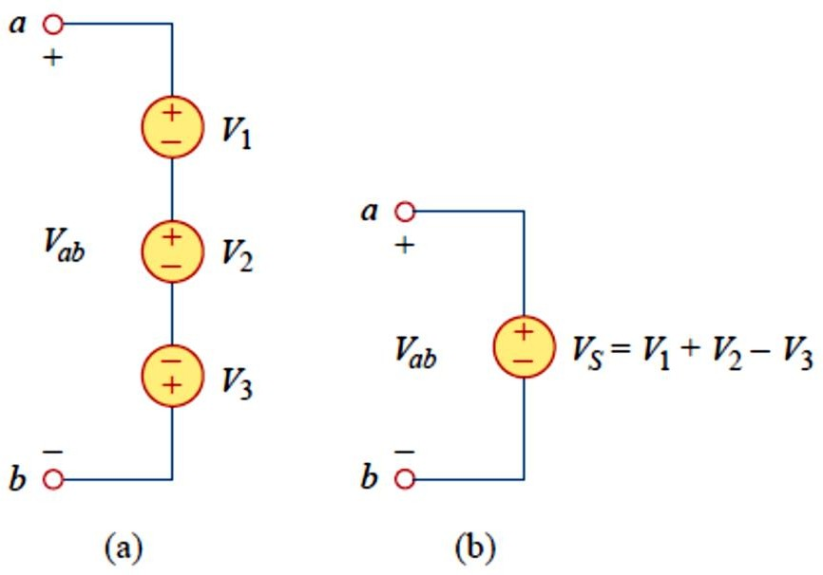
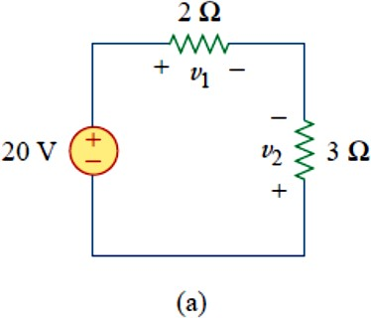
9
Which may be interpreted as
Sum of voltage drops = Sum of voltage rises
When voltage sources are connected in series, KVL can be applied to
obtain the total voltage. The combined voltage is the algebraic sum of the voltages of the individual sources. For example, for the voltage sources shown in Fig. 9(a), the combined or equivalent voltage source in Fig. 9(b) is obtained by applying KVL.
−𝑉_{𝑎𝑏} + 𝑉₁ + 𝑉₂ − 𝑉₃ = 0
Or
𝑉_{𝑎𝑏} = 𝑉₁ + 𝑉₂ − 𝑉₃
Fig. 9 Voltage sources in series: (a) original circuit, (b) equivalent circuit.
Example 6: For the circuit in Fig. 10(a), find voltages 𝒗_{𝟏} and 𝒗_{𝟐}.
Fig. 10

Slide 10
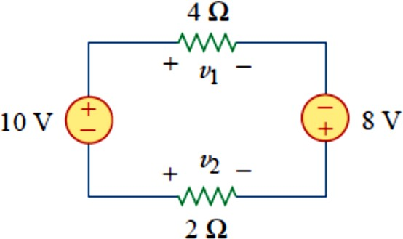
10
Example 7: For the circuit in Fig. 10, find voltages 𝒗_{𝟏} and 𝒗_{𝟐}.
Fig. 11

Slide 11
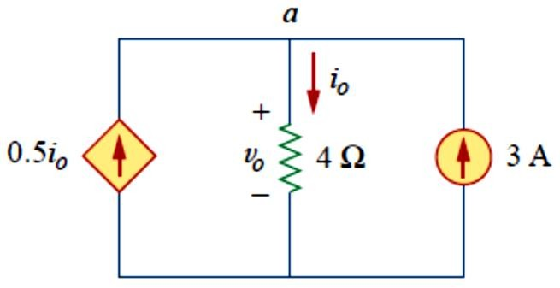
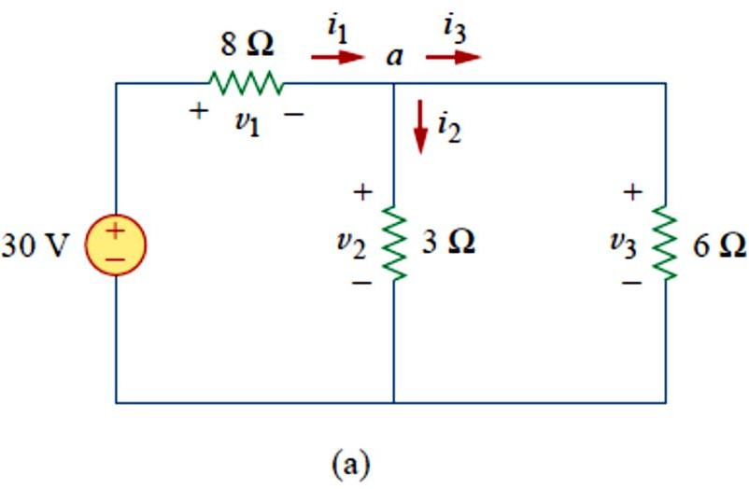
11
Example 8: Find current 𝒊_{𝒐} and voltage 𝒗_{𝒐} in the circuit shown in Fig. 12.
Fig. 12
Example 10: Find the currents and voltages in the circuit shown in Fig.
13 (a)
Fig. 13

Slide 12
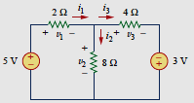
12
H.W. Find the currents and voltages in the circuit shown in Fig. 15
𝑣₁ = 3 𝑉, 𝑣₂ = 2 𝑉, 𝑣₃ = 5 𝑉, 𝑖₁ = 1.5 𝐴, 𝑖₂ = 0.25 𝐴, 𝑖₃ = 1.25 𝐴

